Slide 1
Digital Portfolio
STUDENT NAME: Pranav.N
REGISTER NO AND NMID: asbruaz2426j1540&2426j1540
DEPARTMENT: B.SC.Information Technology
COLLEGE:KPR College Of Arts Science And Reasearch

Slide 2
PROJECT TITLE
Gamified Portfolio

Slide 3
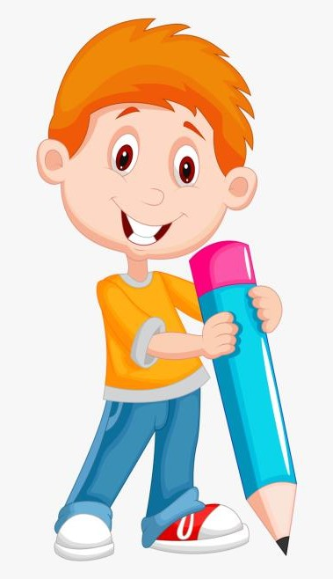

AGENDA
Problem Statement
Project Overview
End Users
Tools and Technologies
Portfolio design and Layout
Features and Functionality
Results and Screenshots
Conclusion
Github Link
3/21/2024 Annual Review

Slide 4

PROBLEM STATEMENT
In today’s competitive job market, traditional resumes and portfolios often fail to capture the attention of recruiters, as most of them look very similar and provide limited engagement.
Job seekers, especially in creative and technical fields, need innovative ways to showcase their skills beyond plain text and static designs. At the same time, employers are looking for candidates who can stand out, demonstrate creativity, and present their abilities in an interactive manner.
A gamified portfolio website addresses this challenge by combining professional achievements with engaging game-like elements (e.g., levels, badges, progress bars, interactive challenges).
This not only makes the portfolio more appealing and memorable but also allows recruiters to explore a candidate’s skills in a fun, interactive, and impactful way.

Slide 5
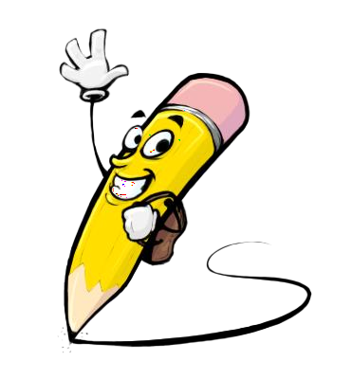
PROJECT OVERVIEW
The Gamified Portfolio Website is an interactive platform designed to showcase an individual’s professional resume, skills, projects, and achievements in a game-like format. Instead of presenting information in a traditional, static manner, the portfolio uses gamification elements such as levels, progress bars, badges, challenges, and achievements to make the user experience engaging and memorable.
This project aims to help job seekers, students, and professionals stand out in a competitive market by combining personal branding with interactive storytelling. The website not only displays academic and career information but also reflects creativity, problem-solving ability, and technical expertise in web development.
By turning a simple resume into an interactive journey, the Gamified Portfolio increases user engagement, leaves a lasting impression on recruiters, and demonstrates the individual’s ability to think outside the box.

Slide 6

WHO ARE THE END USERS?
Recruiters & Hiring Managers – To evaluate candidates in a creative and engaging way.
Employers / Companies – To discover talented individuals who stand out from traditional resumes.
Students & Job Seekers – To showcase their skills, projects, and achievements in an innovative format.
Freelancers & Creatives – To present portfolios (design, coding, art, etc.) in an interactive style to attract clients.
Peers & Networking Communities – To share work and gain feedback in professional or academic circles.

Slide 7
TOOLS AND TECHNIQUES
Programming Languages – HTML, CSS, JavaScript (for structure, styling, and interactivity).
Frameworks / Libraries – React.js or Vue.js (for dynamic UI), Bootstrap or Tailwind CSS (for responsive design).
Gamification Techniques – Levels, badges, progress bars, challenges, leaderboards (to make it engaging).
Database / Storage – Firebase, MongoDB, or MySQL (to store user details, progress, or feedback).
Version Control – Git & GitHub (to manage code changes and collaboration).
Design Tools – Figma, Canva, or Adobe XD (to design layouts and UI/UX flow).
Development Environment – VS Code or WebStorm (for coding and testing).
Deployment Platforms – Netlify, Vercel, or GitHub Pages (to host the portfolio online).

Slide 8
POTFOLIO DESIGN AND LAYOUT
Home (Start Screen) – Name, avatar, “Start Journey” button.
About Me (Character Profile) – Bio, skills shown as levels/progress bars.
Skills (Skill Tree / Power-ups) – Skills as badges or unlocked levels.
Projects (Quest Log) – Projects displayed as missions with badges/trophies.
Experience & Education (Levels) – Career timeline shown as cleared levels.
Contact (Final Stage) – Contact form/social links as “Unlock Next Stage.”
Footer (Game Credits) – Credits styled like game end screen.
Achievements & Badges – Showcase certifications, awards, and milestones as collectible badges.
Leaderboard / Stats – Optional section showing completed projects, GitHub contributions, or hackathon wins like a scorecard.
Dark/Light Mode (Game Themes) – Allow users to switch themes, just like changing game skins.
Interactive Animations – Hover effects, progress animations, or “level-up” effects to make it engaging.
8

Slide 9
FEATURES AND FUNCTIONALITY
Interactive Start Screen – Portfolio opens like a game with a “Start Journey” button.
Profile as Character Card – About section shown as a game avatar with level, XP, and skills.
Gamified Skills Display – Skills shown as progress bars, badges, or power-ups.
Projects as Quests – Each project displayed as a mission/quest with status (Completed / In Progress).
Achievements & Badges – Certifications, awards, and milestones displayed as collectible rewards.
Career Timeline as Levels – Education and experience shown as different levels/stages cleared.
Interactive Animations – Hover effects, progress unlocks, and “level-up” style transitions.
Leaderboard / Stats – Optional section showing GitHub commits, hackathon scores, or coding streaks.
Contact Section (Final Stage) – Recruiters can connect via form, email, or social links styled as “Unlock Next Stage.”

Slide 10
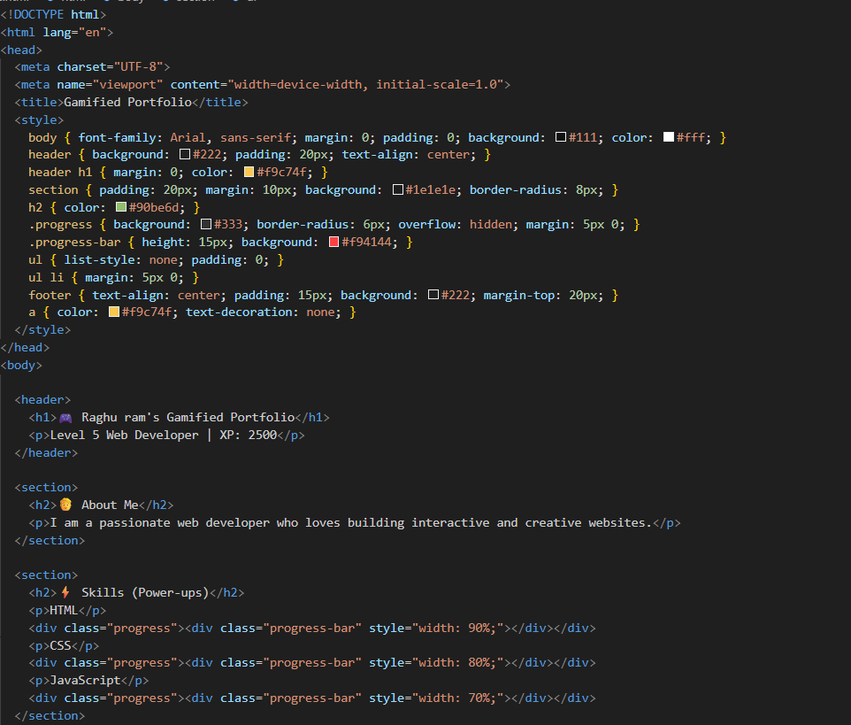
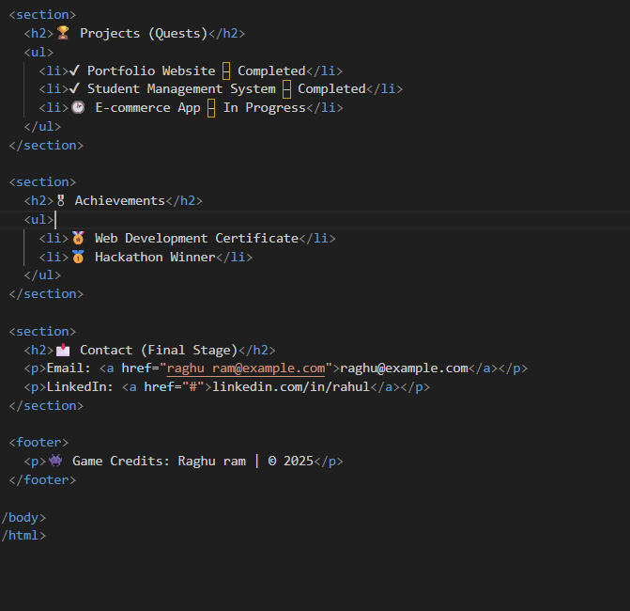
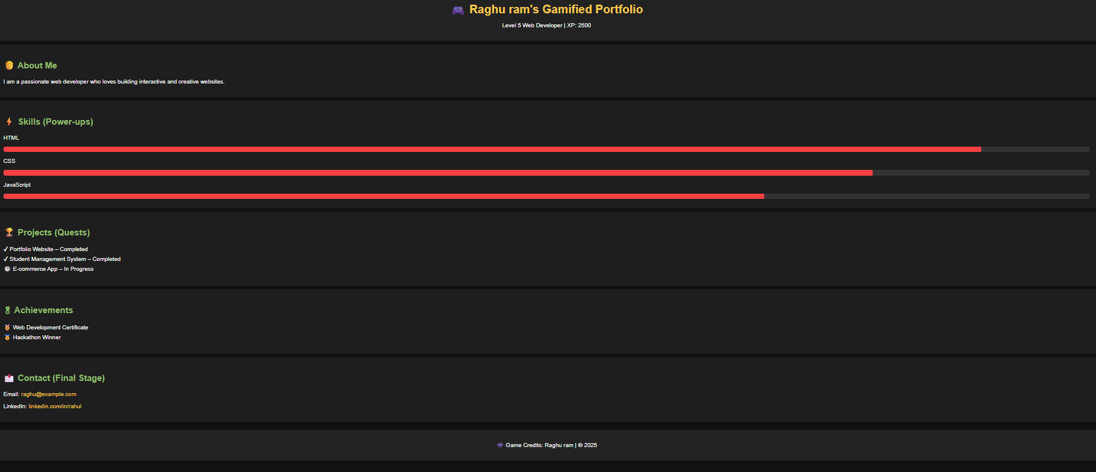
RESULTS AND SCREENSHOTS
3/21/2024 Annual Review
10

Slide 11
CONCLUSION
The Gamified Portfolio transforms a traditional resume into an engaging, interactive experience. By using game-like elements such as levels, quests, achievements, and progress tracking, it not only highlights skills and projects but also captures the attention of recruiters and employers in a creative way. This approach makes personal branding more memorable, enhances user engagement, and provides a modern way to showcase professional growth. Ultimately, a gamified portfolio helps individuals stand out in today’s competitive job market.
11

